Slide 1


SAP S/4HANA CDS, SAC Training Day 15
Anubhav Oberoy

Slide 2
Agenda – Day 15
Close Loop Scenario – The Introduction
Use Case
Build Data Model
Expose Contract
Create V4 Services
Register Service in Gateway
Create Live Data Connection
Build Application with Data Model
Consume Data Actions to write data to BW
Consuming OData Services in SAC
Debugging Applications

Slide 3

Connections
SAP analytic Agent
Public Cloud
Internet
Intranet
Source Systems
BW,BI,S/4H,ABAP,BO,HANA
On premise
SAC
SAP Analytics Cloud System
SAP Cloud Connector
InA
BTP
VPN
PC
S/4HANA, SF
HANA Cloud etc.
Azure, GCP, AWS
InA
Adaptor
www.anubhavtrainings.com

Slide 4
sactrial-sacap10-a5xkyu7zy0i795g99wmt805s.ap10.hanacloudservices.cloud.sap
SAP SAC Server
Browser
Connection to BW or S/4HANA
CORS Headers to browser
Exception to allow CORS call to me from browser
CORS
Cross Origin Resource Sharing
stcfin.st.com:8021/
S/4HANA
BW
ina
Hey! I am fine if someone make a CORS call to me!

Slide 5
CORS
https://sactrial-saceu10-f4aajqsq4u7m952hny9vpm8p.eu10.hanacloudservices.cloud.sap/
SAP Analytics Cloud
SCP
Browser
CORS
CORS Headers
SAC system
BW, BI, BO, ECC….
SAP S/4HANA
On Premise
Special permission
ina
http://sts4dev.st.com:8001/sap/bw/ina/getresponse?sap-client=800
www.anubhavtrainings.com

Slide 6
NW versions required to release CORS Headers
Check the system version of your ABAP based system
NW 7.52 SP02
NW 7.51 SP06
NW 7.50 SP13
NW 7.40 SP20
SAP Kernel Version 7.49PL315
2. Check if INA Service is active in the system. TCOODE: SICF and search for INA service
3. The system must be SSH enabled, HTTPS signed certificate (Network admin)- STRUST
4. Inform Our SAP system that we can offer CORS headers RZ10(system wide-need NW restart)
RZ11 (temporary)
icf/cors_enabled
5. For On-premise systems running in Intranet, you need sap cloud connector
6. Add the settings to issue CORS headers to browser for your SAC system - UCONCOCKPIT
https://help.sap.com/viewer/00f68c2e08b941f081002fd3691d86a7/release/en-US/0d1cd72013804eb78e2aea45a562e439.html?q=uconcockpit
www.anubhavtrainings.com

Slide 7
SAC
HANA
Calculation View
(data model)
ABAP on HANA training 9th April 2022
Weekend 7-9 IST
SAC
S/4HANA (ERP)
CDS View
(data model)

Slide 8
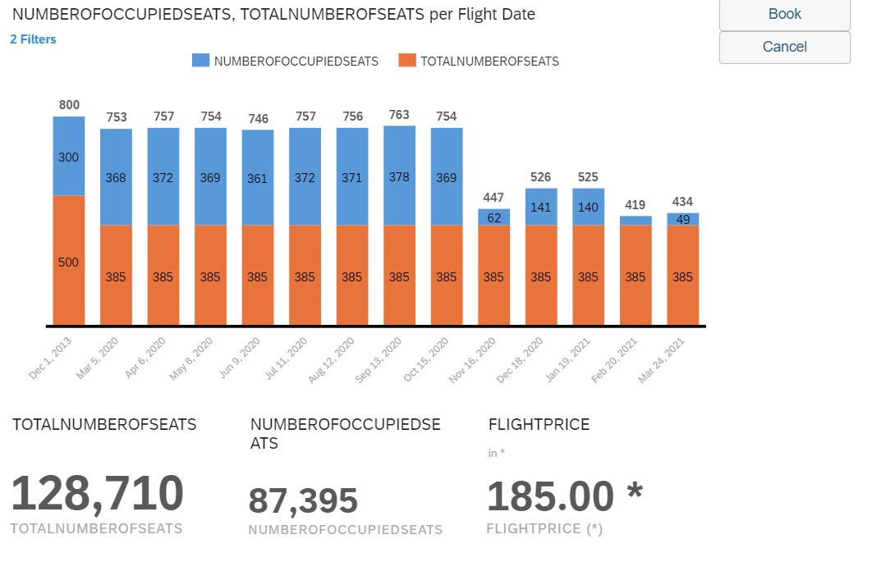
<Title>
www.anubhavtrainings.com

Slide 9

Questions?

Slide 10


Thank you
Anubhav.abap@gmail.com
contact@anubhavtrainings.com
+91 84484 54549
www.anubhavtrainings.com

